Slide 1
IST687 – Applied Data Science
Words?

Slide 2
Data Science
Chapter Objectives
Gain experience analyzing unstructured data
Basic understanding and application of text mining techniques such as word clouds and sentiment analysis
Practice text mining techniques in R

Slide 3
Data Science
An example of unstructured data:
Friends and fellow citizens: I stand before you tonight under indictment for the alleged crime of having voted at the last presidential election, without having a lawful right to vote. It shall be my work this evening to prove to you that in thus voting, I not only committed no crime, but, instead, simply exercised my citizen's rights, guaranteed to me and all United States citizens by the National Constitution, beyond the power of any state to deny.
The preamble of the Federal Constitution says:
"We, the people of the United States, in order to form a more perfect union, establish justice, insure domestic tranquillity, provide for the common defense, promote the general welfare, and secure the blessings of liberty to ourselves and our posterity, do ordain and establish this Constitution for the United States of America."
It was we, the people; not we, the white male citizens; nor yet we, the male citizens; but we, the whole people, who formed the Union. And we formed it, not to give the blessings of liberty, but to secure them; not to the half of ourselves and the half of our posterity, but to the whole people - women as well as men. And it is a downright mockery to talk to women of their enjoyment of the blessings of liberty while they are denied the use of the only means of securing them provided by this democratic-republican government - the ballot.

Slide 4
Data Science
Text Mining vs Natural Language Processing
TM :
Looking for unexpected patterns in large data sets
Focuses on statistical approaches to analyzing text data, using strategies such as counting word frequencies in a corpus
NLP:
Understand how machines can be programmed to digest and make sense of human language
Use linguistics to break text into its component grammatical pieces such as nouns and verbs

Slide 5
Data Science
Building a Word Cloud

Slide 6
Data Science
Use Text Mining to build a Word Cloud
Extract text from a speech (or any other text)
Build a term-document matrix (from text)
Find Frequent words and associations from the matrix.
A word cloud is used to present frequently occurring words in documents.

Slide 7
Data Science
Text Mining Packages
tm: provides functions for text mining,
wordcloud: visualizes results.

Slide 8
Data Science
One way to read in text
> sbaFile <- “http://www.historyplace.com/speeches/anthony.htm”
> sba <- readLines(sbaFile)
> str(sba)
chr [1:15] "Friends and fellow citizens: I stand before you tonight under indictment for the alleged crime of having voted at the last pres"| __truncated__ …

Slide 9
Data Science
We First Need to Build a Corpus:
A Corpus is a “Bag of Words”
We coerce our text file vector (‘sba’) into a custom "Class" provided by the tm package called a "Corpus"
The Corpus Class defines the most fundamental object that text miners care about, a corpus containing a collection of documents

Slide 10
Data Science
Four Transformations:
Making all of the letters lowercase
Removing the punctuation
Removing numbers
Taking out the "stop" words
Words such as "the," "a," and "at" appear in so many different parts of the text that they are useless for differentiating between documents.

Slide 11
Data Science
Four Transformations:
> words.vec <- VectorSource(sba)
> words.corpus <- Corpus(words.vec)
> words.corpus
<<VCorpus>>
Metadata: corpus specific: 0, document level (indexed): 0
Content: documents: 15
> words.corpus <- tm_map(words.corpus, content_transformer(tolower))
> words.corpus <- tm_map(words.corpus, removePunctuation)
> words.corpus <- tm_map(words.corpus, removeNumbers)
> words.corpus <- tm_map(words.corpus, removeWords, stopwords("english"))

Slide 12
Data Science
A term-document matrix:
A rectangular data structure with terms (words) as the rows and documents as the columns
A term may be a single word, for example, "biology," or it could also be a compound word, such as "data analysis."
If a term like "data" appears once in the first document, twice in the second, and not at all in the third document, then the column for the term data will contain 1, 2, 0.
Most term document matrices are quite sparse - the overwhelming number of cells that contain zero - indicating that the term does not appear in a document.

Slide 13
Data Science
Creating a TermDocumentMatrix
> tdm <- TermDocumentMatrix(words.corpus)
> tdm
<<TermDocumentMatrix (terms: 189, documents: 15)>>
Non-/sparse entries: 225/2610
Sparsity : 92%
Maximal term length: 20
Weighting : term frequency (tf)

Slide 14
Data Science
The Wordcloud function:
Expects two vectors as input arguments:
the first a list of the terms
the second a list of the frequencies of occurrence of the terms.
The list of terms and frequencies must be sorted with the most frequent terms appearing first.
we first have to coerce our text data back into a plain data matrix so that we can sort it by frequency.

Slide 15
Data Science
Create the WordCloud
> m <- as.matrix(tdm)
> wordCounts <- rowSums(m)
> wordCounts <- sort(wordCounts, decreasing=TRUE)
> head(wordCounts)
women citizens oligarchy people states blessings
7 6 5 5 5 4
> cloudFrame<-data.frame( + word=names(sortedMatrix),freq=sortedMatrix)
> wordcloud(cloudFrame$word,cloudFrame$freq)

Slide 16
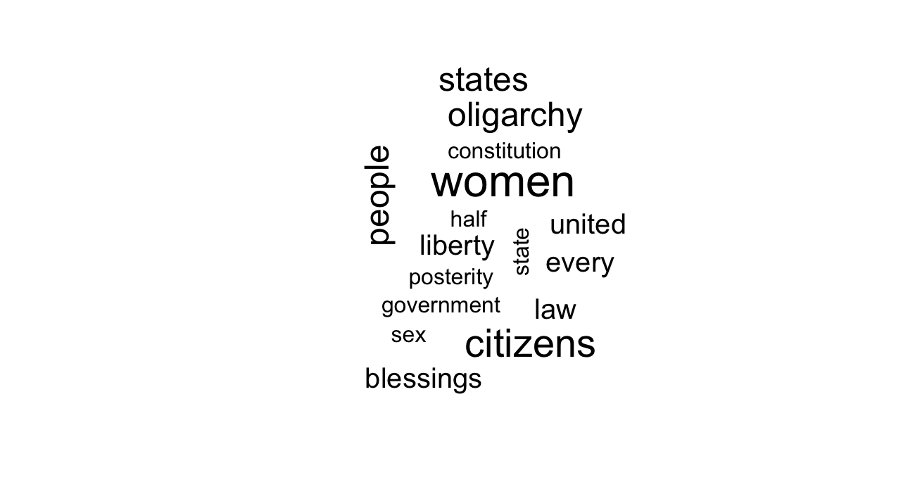
Data Science
WordCloud Example

Slide 17
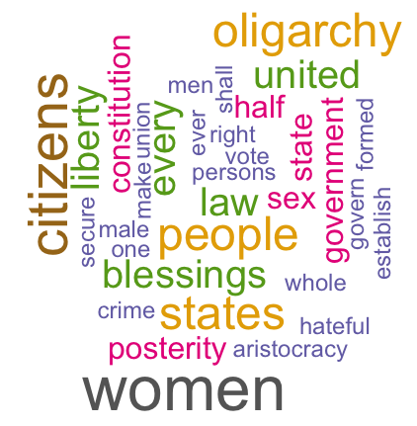
Data Science
wordcloud(names(wordCounts), wordCounts, min.freq=2, +
max.words=50, rot.per=0.35, colors=brewer.pal(8, "Dark2"))

Slide 18
Data Science
Q: How useful are word Clouds?

Slide 19
Data Science
Sentiment Analysis

Slide 20
Data Science
Conceptual Methodology:
Load Positive and Negative Word Lists
Count positive words and negative words (in entire document or part of a document)
Compute the ratio of positive to negative words

Slide 21
Data Science
Get the Positive and Negative Word Files
Access to positive and negative words:
https://www.cs.uic.edu/~liub/FBS/sentiment-analysis.html
> pos <- "positive-words.txt"
> neg <- "negative-words.txt"
> #read the files
> p <- scan(pos, character(0),sep = "\n") # separate each word
Read 2040 items
> n <- scan(neg, character(0),sep = "\n") # separate each word
Read 4817 items

Slide 22
Data Science
Clean up the positive and negative words files:
> p <- p[-1:-34]
> n <- n[-1:-34]
> head(p, 10)
[1] "a+" "abound" "abounds" "abundance" "abundant" "accessable"
[7] "accessible" "acclaim" "acclaimed" "acclamation"
> head(n,10)
[1] "2-faced" "2-faces" "abnormal" "abolish" "abominable" "abominably"
[7] "abominate" "abomination" "abort" "aborted"

Slide 23
Data Science
Get the total number of words
#calculate the total number of words
> totalWords <- sum(wordCounts)
#have a vector that just has all the words
words <- names(wordCounts)
> matched <- match(words, p, nomatch = 0)
> head(matched,10)
[1] 0 0 0 0 0 0 0 0 1083 0

Slide 24
Data Science
Explore the matched words:
> matched[9]
[1] 1083
> p[1083]
[1] "liberty"
> words[9]
[1] "liberty"

Slide 25
Data Science
Calculate the positive word counts:
> mCounts <- wordCounts[which(matched != 0)]
> length(mCounts)
[1] 12
> mWords <- names(mCounts)
> nPos <- sum(mCounts)
> nPos
[1] 17

Slide 26
Data Science
Calculate the negative word counts:
> matched <- match(words, n, nomatch = 0)
> nCounts <- wordCounts[which(matched != 0)]
> nNeg <- sum(nCounts)
> nWords <- names(nCounts)
> nNeg
[1] 13
> length(nCounts)
[1] 11

Slide 27
Data Science
Calculate the sentiment:
> #calculate the percentage of words that are positive or negative
> totalWords <- length(words)
> ratioPos <- nPos/totalWords
> ratioPos
[1] 0.08994709
> ratioNeg <- nNeg/totalWords
> ratioNeg
[1] 0.06878307
Given this, we can see that Susan B. Anthony’s speech was about 9% positive and a little less than 7% negative

Slide 28
Data Science
Q: Does this truly measure sentiment? Where could it go wrong?
Notes:
Some words are more negative / positive than others
Slang (
Discussions about a movie – talking about something “bad” in the movie (not that the movie is bad).

Slide 29
Data Science
Review web site
Notes:
Some words are more negative / positive than others
Slang (
Discussions about a movie – talking about something “bad” in the movie (not that the movie is bad).

